Slide 1
Job Shop Scheduling Optimization using Heuristic Processes
Name :- Jeet Oza
Roll No. :- ME09B113

Slide 2
Why Heuristic Process?
Difficulty in Solving by traditional method
May not give optimal Solution
Faster than traditional methods
Get stuck at local optimum

Slide 3
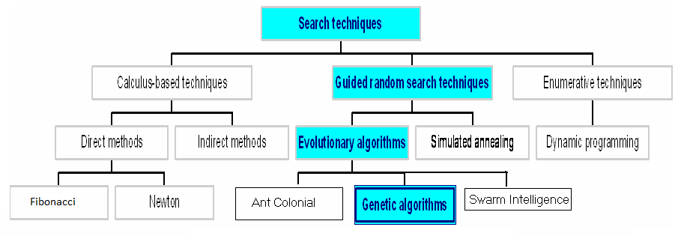
Different Heuristics Methods

Slide 4
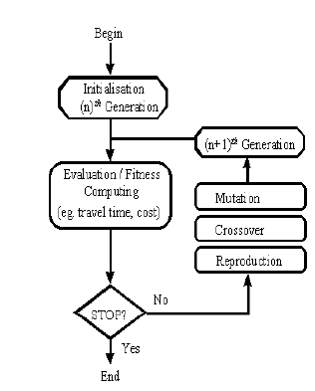
Genetic Algorithm

Slide 5
Job Shop Scheduling
one of the most general and difficult of all traditional scheduling problems
Problem: N machine, M job
Minimize the time required

Slide 6
Method Used
Make 2 Genes by a function
In each gene make 3 changes randomly
Total 4 genes -> make them in decresing order of objective function
Kill top two and change bottom 2 thrice randomly

Slide 7
Problem 1
Job | Machine Sequence | Time allocation
1 | 1,2,4,3 | p11=6, p21=8,p41=6, p31=4
2 | 2,1,3,4 | p22=8, p12=3, p32=6, p42=5
3 | 1,4,2 | p13=4, p43=3, p23=7

Slide 8
Formulation
Variables:
t_{ij} = start time of job j on machine i, for i = 1,2,3 and j =1,2,3
x_{ijk} = 1, if job j precedes job k on machine i,
0, otherwise for i = 1,2,3,4
j =1,2,3 and j < k
Min C_{max}
s.t
C_{max} ≥ t₃₁ + p₃₁
C_{max} ≥ t₄₂ + p₄₂
C_{max} ≥ t₂₃ + p₂₃

Slide 9
Machine precedence in job constraint
t21 >= t11 + 6
t41 >= t21 + 8
t31 >= t41 + 6
t12 >= t22 + 8
t32 >= t12 + 3
t42 >= t32 + 6
t43 >= t13 + 4
t23 >= t43 + 3

Slide 10
Job precedence in machine constraint
t_{i1} + p_{i1} ≤ t_{i2} + M(1-x_{i12}) for i=1,2,3,4
t_{i2} + p_{i2} ≤ t_{i1} + M x_{i12}
t_{i1} + p_{i1} ≤ t_{i3} + M(1-x_{i13})
t_{i3} + p_{i3} ≤ t_{i1} + M x_{i13}
t_{i2} + p_{i2} ≤ t_{i3} + M(1-x_{i23})
t_{i3} + p_{i3} ≤ t_{i2} + M x_{i23}
t_{ij} ≥ 0, for i=1,2,3,4 and j=1,2,3
x_{ijk} ∈ {0,1} for i = 1,2,3,4 j =1,2,3 and j < k

Slide 11
Value got by different runs
Figure number | Best value | Second Best Value
1 | 27 | 27
2 | 27 | 27
3 | 27 | 27
4 | 30.4 | 32
5 | 27 | 27
6 | 27 | 29
7 | 27 | 27
8 | 27 | 29
9 | 29 | 32
10 | 27 | 27

Slide 12
figure | Machine1 | Machine2 | Machine3 | Machine4 | Fn value
1 | 1-3-2 | 2-1-3 | 3-2-1 | 3-1-2 | 27
2 | 1-3-2 | 2-1-3 | 3-2-1 | 3-1-2 | 27
3 | 1-3-2 | 2-1-3 | 3-2-1 | 3-1-2 | 27
4 | 3-2-1 | 1-2-3 | 3-2-1 | 3-1-2 | 30.4
5 | 1-3-2 | 2-1-3 | 3-2-1 | 3-1-2 | 27
6 | 1-3-2 | 2-1-3 | 3-2-1 | 3-1-2 | 27
7 | 1-3-2 | 2-1-3 | 3-2-1 | 3-1-2 | 27
8 | 1-3-2 | 2-1-3 | 3-2-1 | 3-1-2 | 27
9 | 1-2-3 | 2-1-3 | 3-2-1 | 3-1-2 | 29
10 | 1-3-2 | 2-1-3 | 3-2-1 | 3-1-2 | 27

Slide 13
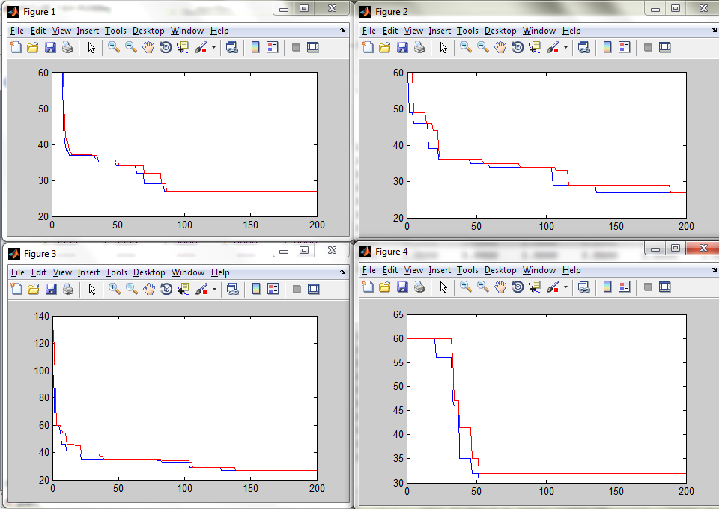

Slide 14
Gene change : 2
figure | Machine1 | Machine2 | Machine3 | Machine4 | Fn value
1 | 1-3-2 | 2-1-3 | 3-2-1 | 3-1-2 | 27
2 | 3-1-2 | 2-1-3 | 3-2-1 | 3-1-2 | 29
3 | 1-3-2 | 2-1-3 | 3-2-1 | 3-1-2 | 27
4 | 1-3-2 | 2-1-3 | 3-2-1 | 3-1-2 | 27
5 | 1-3-2 | 2-1-3 | 3-2-1 | 3-1-2 | 27
6 | 3-1-2 | 2-1-3 | 3-2-1 | 3-1-2 | 29
7 | 1-3-2 | 2-1-3 | 3-2-1 | 3-1-2 | 27
8 | 1-3-2 | 2-1-3 | 3-2-1 | 3-1-2 | 27
9 | 1-3-2 | 2-1-3 | 3-2-1 | 3-1-2 | 27
10 | 1-3-2 | 2-1-3 | 3-2-1 | 3-1-2 | 27

Slide 15
Gene change : 4
figure | Machine1 | Machine2 | Machine3 | Machine4 | Fn value
1 | 1-3-2 | 2-1-3 | 3-2-1 | 3-1-2 | 27
2 | 3-1-2 | 2-1-3 | 3-2-1 | 3-1-2 | 29
3 | 1-3-2 | 2-1-3 | 3-2-1 | 3-1-2 | 27
4 | 1-3-2 | 2-1-3 | 3-2-1 | 3-1-2 | 27
5 | 3-1-2 | 2-1-3 | 3-2-1 | 3-1-2 | 29
6 | 3-1-2 | 2-3-1 | 3-2-1 | 3-1-2 | 34
7 | 1-3-2 | 2-1-3 | 3-2-1 | 3-1-2 | 27
8 | 1-3-2 | 2-1-3 | 3-2-1 | 3-1-2 | 27
9 | 3-1-2 | 2-1-3 | 3-2-1 | 3-1-2 | 29
10 | 1-3-2 | 2-1-3 | 3-2-1 | 3-1-2 | 27

Slide 16
Gene change : 5
figure | Machine1 | Machine2 | Machine3 | Machine4 | Fn value
1 | 1-3-2 | 2-1-3 | 3-2-1 | 3-1-2 | 27
2 | 3-1-2 | 2-3-1 | 3-2-1 | 3-1-2 | 34
3 | 1-2-3 | 2-1-3 | 3-2-1 | 1-3-2 | 32
4 | 3-1-2 | 2-1-3 | 3-2-1 | 3-1-2 | 29
5 | 1-2-3 | 2-1-3 | 3-2-1 | 1-3-2 | 32
6 | 1-3-2 | 2-1-3 | 3-2-1 | 3-1-2 | 27
7 | 1-2-3 | 2-1-3 | 3-2-1 | 1-3-2 | 32
8 | 1-3-2 | 2-1-3 | 3-2-1 | 3-1-2 | 27
9 | 3-2-1 | 1-2-3 | 3-2-1 | 3-1-2 | 30.4
10 | 3-1-2 | 2-1-3 | 3-2-1 | 3-1-2 | 29

Slide 17
Gene change : 6
figure | Machine1 | Machine2 | Machine3 | Machine4 | Fn value
1 | 1-2-3 | 2-1-3 | 3-2-1 | 1-3-2 | 32
2 | 1-3-2 | 2-1-3 | 3-2-1 | 3-1-2 | 27
3 | 1-3-2 | 2-1-3 | 3-2-1 | 3-1-2 | 27
4 | 1-3-2 | 2-1-3 | 3-2-1 | 3-1-2 | 27
5 | 1-2-3 | 2-1-3 | 3-2-1 | 1-3-2 | 32
6 | 1-2-3 | 2-1-3 | 3-2-1 | 3-2-1 | 33
7 | 3-2-1 | 1-2-3 | 3-2-1 | 3-1-2 | 30.4
8 | 3-2-1 | 1-2-3 | 3-2-1 | 3-1-2 | 30.4
9 | 1-2-3 | 2-1-3 | 3-2-1 | 1-3-2 | 32
10 | 1-2-3 | 2-1-3 | 3-2-1 | 3-1-2 | 29

Slide 18
Problem 2
Job | Machine Sequence | Time allocation
1 | 1,2,3,4 | p11=10, p21=8,p41=6, p31=7
2 | 2,1,4,3 | p22=8, p12=5, p32=6, p42=5
3 | 4,1,2 | p13=4, p43=4, p23=7
figure | Machine1 | Machine2 | Machine3 | Machine4 | Fn value
1 -6 | 1-2-3 | 2-1-3 | 3-1-2 | 3-2-1 | 31
7 | 3-1-2 | 2-1-3 | 1-3-2 | 3-1-2 | 46.7
8-10 | 1-2-3 | 2-1-3 | 3-1-2 | 3-2-1 | 31

Slide 19
PROBLEM 3
Job | Machine Sequence | Time allocation
1 | 3,4,1,2 | p11=5, p21=3, p31=7,p41=6
2 | 2,4,1,3 | p12=3,p22=4, p32=2, p42=3
3 | 4,3,2,1 | p13=4, p23=3, p33=4, p43=5
figure | Machine1 | Machine2 | Machine3 | Machine4 | Fn value
1 -5,7,8 | 2-1-3 | 2-3-1 | 1-3-2 | 3-2-1 | 23
6,9,10 | 1-2-3 | 2-3-1 | 1-3-2 | 3-1-2 | 25

Slide 20
Conclusion:
By above method we can find the optimal time in Job-shop scheduling.
Optimal time for problem1 = 27
Optimal time for problem2 = 39
This might not be the best solution but mostly near optimal.

Slide 21
Future studies
We can extend this to n Jobs, m Machine problem
Here we have taken only one product of each job and optimized, we can make that for i^{th} product we want quantity x_{i}
We can add time constraint with penalty for extra time or maximize total profit.

Slide 22
References
http://www.mathworks.in/help/gads/ga.html
http://www.vit.ac.in/academicresearch/res701/RES701DUMP/Evolutionary%20Algorithms/GATutorial.pdf

Slide 23
THANK
YOU

